Slide 1


Slide 2
Creative Force
We want to make fun and engaging games that are creative and take it to the next level.

Slide 3

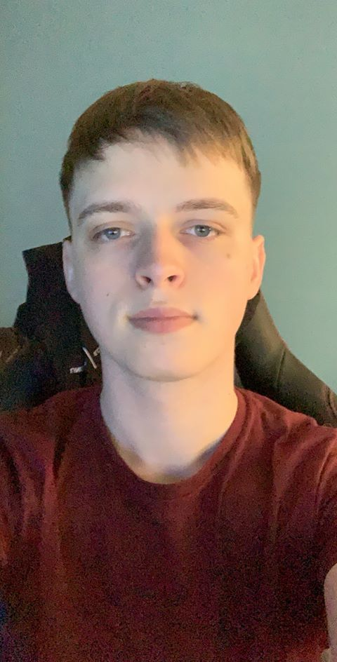


Company Development Team
Calum – Team Leader/ programmer
Experience leading teams and setting deadlines, organising the team.
Pawel – Level Designer
Experience creating fun and exiting levels, always sharing new ideas.
Brodie – Programmer
Experienced programmer, participated in GameJams, able to stick to deadlines.
Samuel – 3D Artist
Experience in environment and character modelling, Takes constructive feedback well.

Slide 4
CyberFocus
CyberFocus is a first person, parkour, time bending experience where players will test their skills and reactions to overcome challenges.

Slide 5
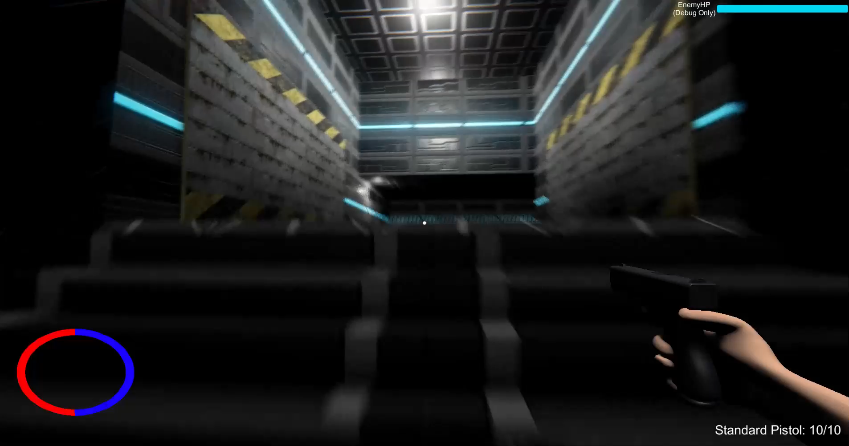
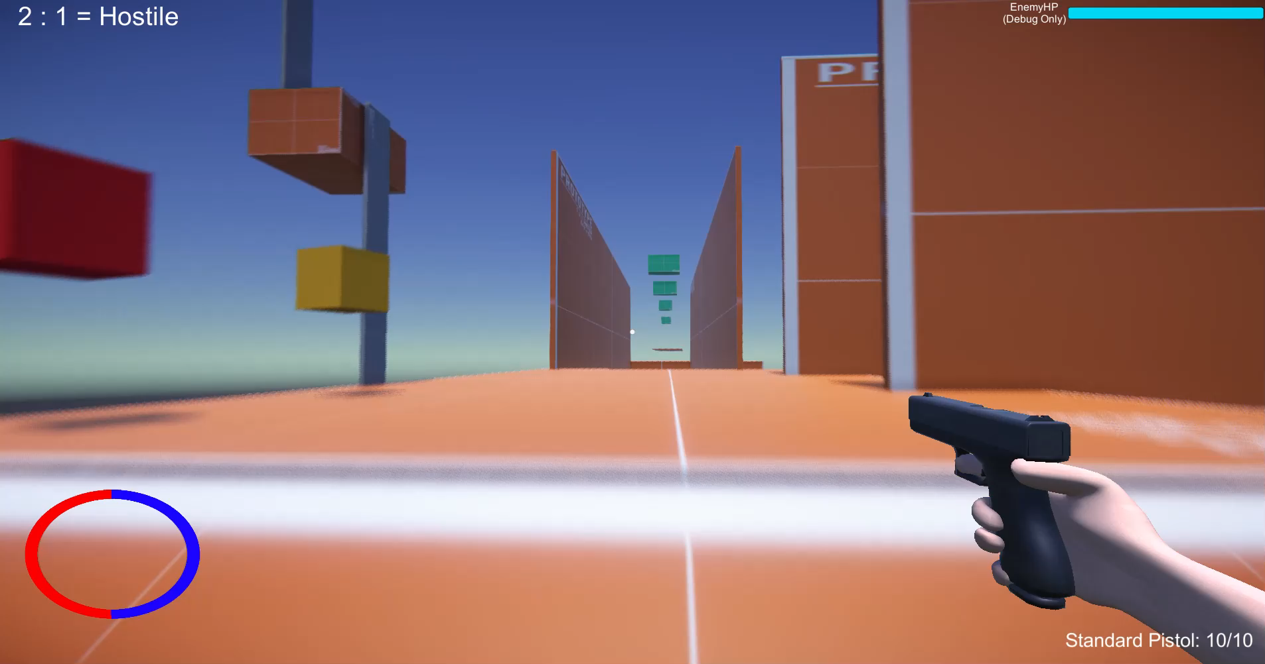
Parkour
What players expect to be in a parkour game.
Hook to propel player

Slide 6
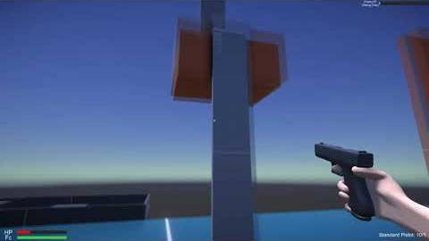
Time Control
The world slows around the player
Bullets, enemies slow for satisfying results.
Notes:
Backstory: set in the future, the player is designed by a company that specialises in cyborg technology. With them being a cyborg, they have the ability to wall run, slow down time and parkour.
In the next slide we will discuss the 3 phase model we are creating for the player to follow and understand the game better.

Slide 7
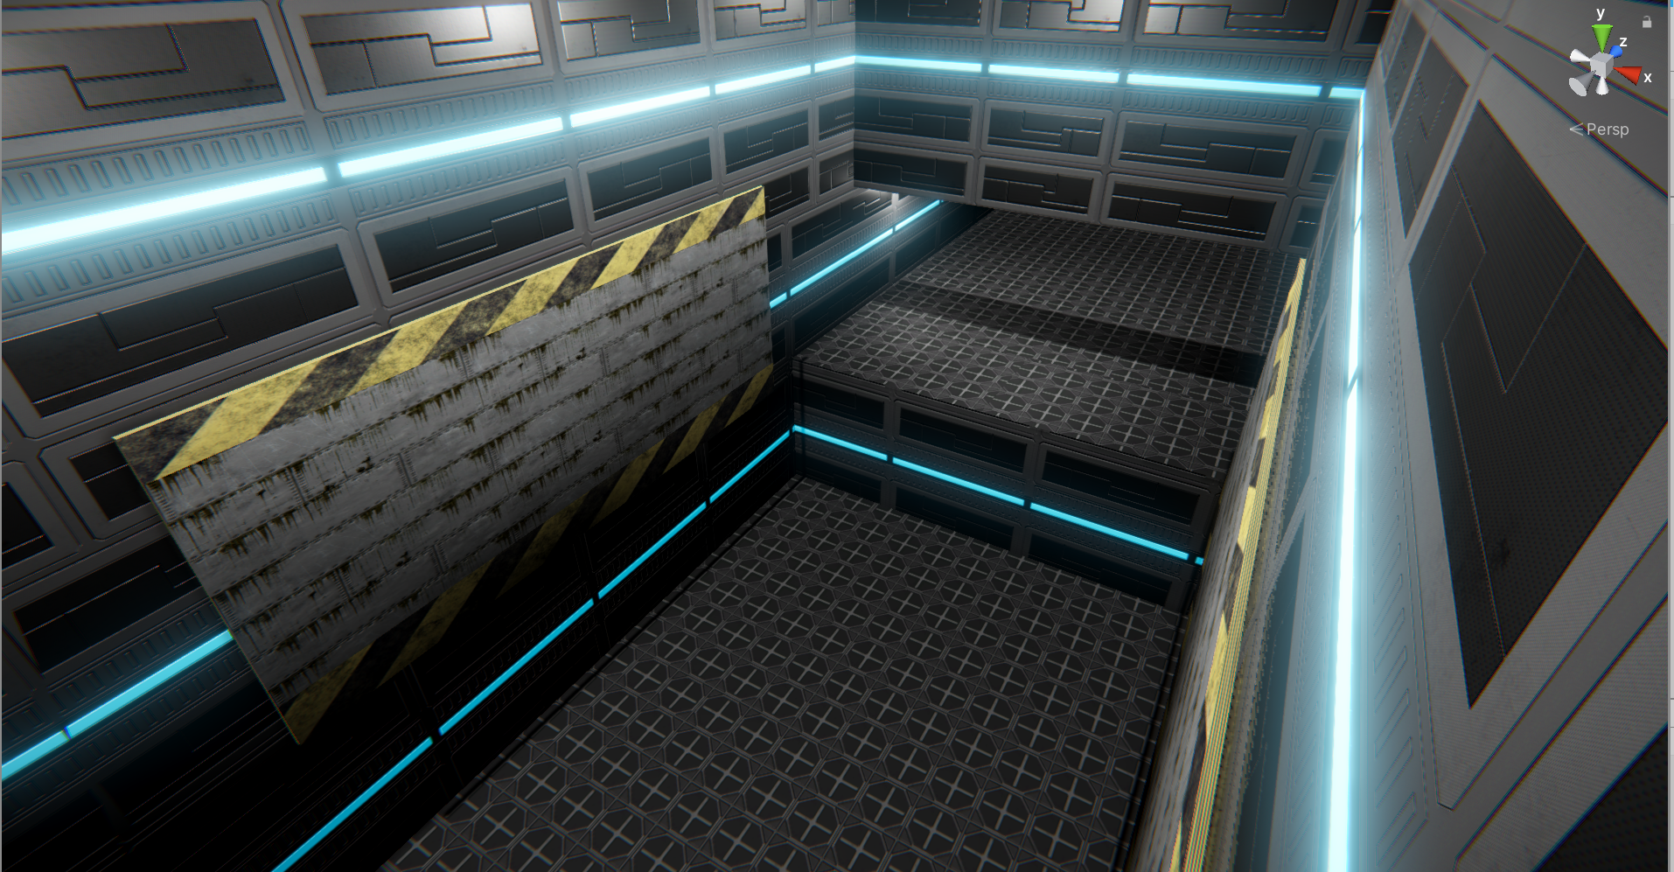
Combat
Real time
Bullets slow down (similar to SuperHot)
Parkour with this combat to produce enjoyable results.
Notes:
Backstory: set in the future, the player is designed by a company that specialises in cyborg technology. With them being a cyborg, they have the ability to wall run, slow down time and parkour.
In the next slide we will discuss the 3 phase model we are creating for the player to follow and understand the game better.

Slide 8
Marketing Plan
Conference + Trade Shows | Publisher to help with funding
Trailers | Own YouTube Channel
Community Building | Twitter/YouTube/Discord
PR + Marketing | Contractor -> Publisher
Notes:
Backstory: set in the future, the player is designed by a company that specialises in cyborg technology. With them being a cyborg, they have the ability to wall run, slow down time and parkour.
In the next slide we will discuss the 3 phase model we are creating for the player to follow and understand the game better.

Slide 9
Production Timeline
June
Character Movement + Wall running begin
Environment placement
Basic parkour
July
Wall Running
Hook Mechanic
Slow down time Enemies
August
All features to be polished Main level finished
Community Building
PR + Marketing
September
Further polish
Community Building
PR + Marketing
Notes:
Backstory: set in the future, the player is designed by a company that specialises in cyborg technology. With them being a cyborg, they have the ability to wall run, slow down time and parkour.
In the next slide we will discuss the 3 phase model we are creating for the player to follow and understand the game better.

Slide 10
Budget
Programming | £24,000
Level Design | £12,000
Art | £18,000
Sound Design | £6,000
PR + Marketing Website, trailer etc | £40,000
TOTAL | £100,000
Notes:
Backstory: set in the future, the player is designed by a company that specialises in cyborg technology. With them being a cyborg, they have the ability to wall run, slow down time and parkour.
In the next slide we will discuss the 3 phase model we are creating for the player to follow and understand the game better.

Slide 11
Funding
Tranzfuser | £25,000
Publisher | £75,000
TOTAL | £100,000
Notes:
Backstory: set in the future, the player is designed by a company that specialises in cyborg technology. With them being a cyborg, they have the ability to wall run, slow down time and parkour.
In the next slide we will discuss the 3 phase model we are creating for the player to follow and understand the game better.

Slide 12
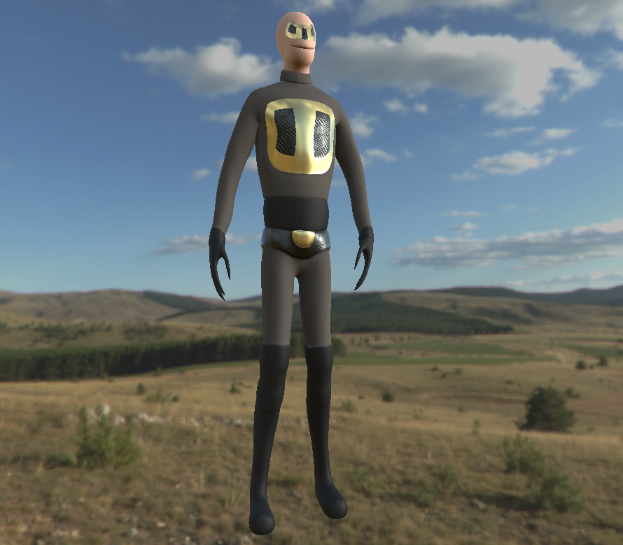
Recap
What is it?
Why is it fun?
Why would someone want to play it?
Notes:
Backstory: set in the future, the player is designed by a company that specialises in cyborg technology. With them being a cyborg, they have the ability to wall run, slow down time and parkour.
In the next slide we will discuss the 3 phase model we are creating for the player to follow and understand the game better.

Slide 13
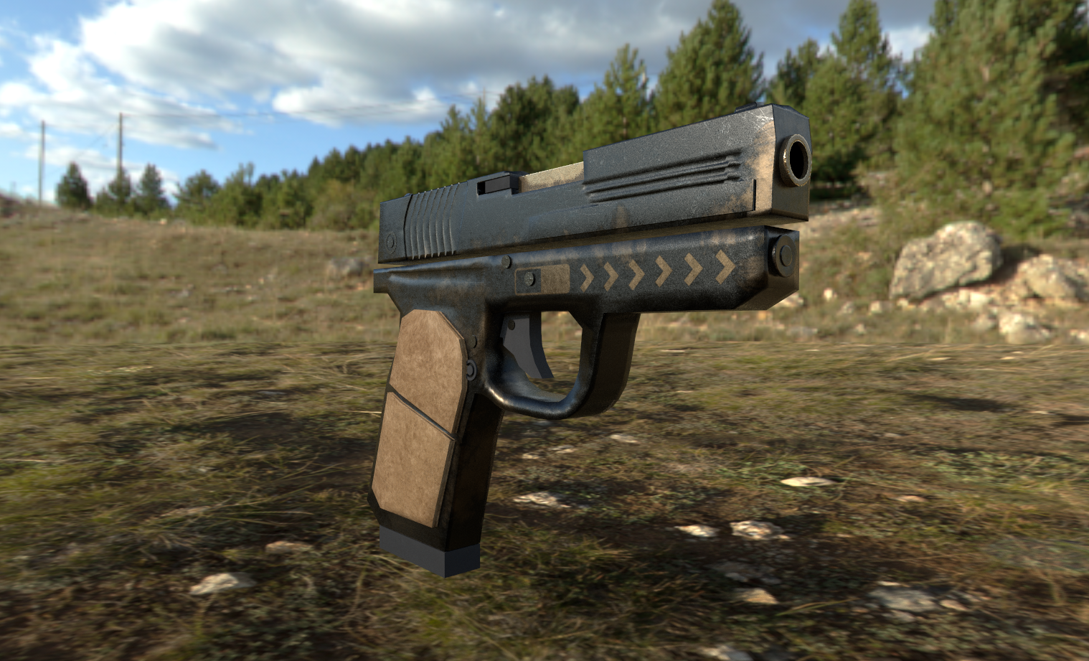
Looking For
Development Funding
Store support
Marketing support
A partner who understands us and our game

Slide 14
Thank You
Contact:
creativeforce532@gmail.com

